Slide 1
Tamil text to English speech using UNL

Slide 2
POS Tagger
Morphological Analyzer
Input
Wordnet Communicator
UNL Enconverter
UNL
UNL Deconverter
English
words
Text
UNL Rules
Identified
Emotion
Corpus
English Text
TTS Engine
Voic Modifier
Voice wih emotions

Slide 3
After Analyser

Slide 4
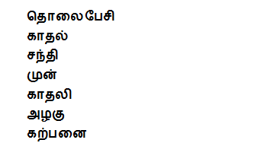
Epitome of the scene

Slide 5
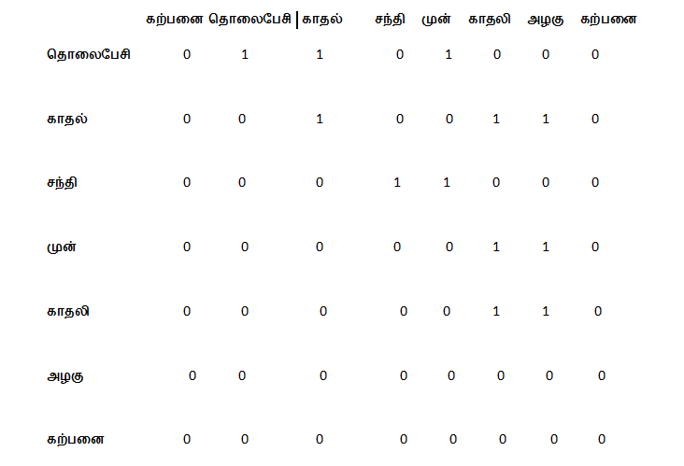
Adjacency matrix

Slide 6
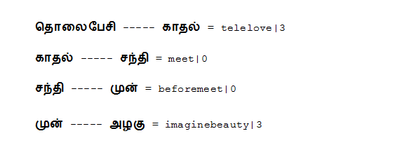
Longest path retrieved

Slide 7
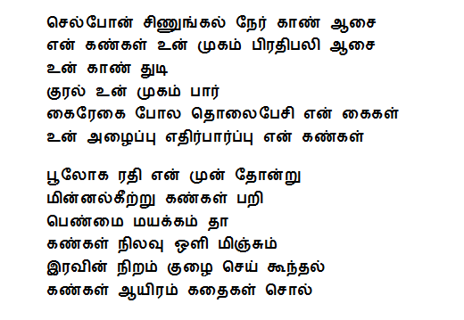
Words given to generator

Slide 8
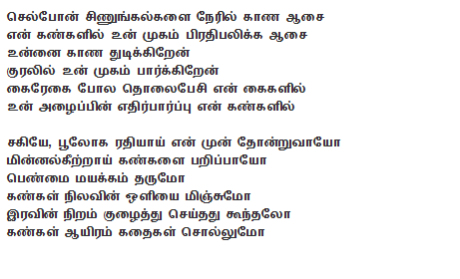
lyrics generated

